Slide 1

Biz Ops Manager
Connecteam Home Assignment
February, 2025
Exploring Customer Journey
Pipeline Analysis and insights
Mike Teitelbaum
Github

Slide 2
Connecteam Home Assignment
February, 2025
Assignment Overview
Wireframe & Customer Journey
Data Analysis & Reporting
Mapping the journey from
prospect to customer..
Identifying key insights from
raw sign-up data.

Slide 3
Connecteam Home Assignment
February, 2025
Agenda
01. Assignment Overview
02. Customer Journey Wireframe (Overview)
03. Data Analysis Approach
04. Key Data Insights & Visuals
05. HubSpot Integration & Dashboard
06. Conclusion & Next Steps

Slide 4
Connecteam Home Assignment
February, 2025
Customer Journey Wireframe (Overview)
Sales Funnel
MIRO (URL).
Marketing: Inbound channels & SDRs for outbound
SDRs: Integrated into customer journey
Sales: Pipeline stages, integrations, tools, quotas
CS: Engagement and day one alignment
Billing: Chargebee integration with HubSpot

Slide 5

Connecteam Home Assignment
February, 2025
Data Analysis
Data URLs:
BizOp_EDA
DQ Lead Analysis
BOM Report
Github
Key Figures
Conversion Rate: 17% (Signup → Paid) Lead Drop-off Rate: 25% at MQL → Demo stage Average Time Delays: 4 days between MQL → Demo, 7 days between Demo → Paid
Conversion Funnel Analysis
Bottleneck: 25% of leads drop off at the MQL → Demo stage, resulting in a significant reduction in conversion potential.
Stage to Stage Velocity: The average time delay between MQL → Demo is 4 days, while Demo → Paid takes 7 days, suggesting inefficiencies in these stages.
Actionable Insight: Reverse engineer to understand if it’s a process issue or a headcount issue. Reducing SLA by 1-2 days could improve sales velocity by approximately 10%.

Slide 6
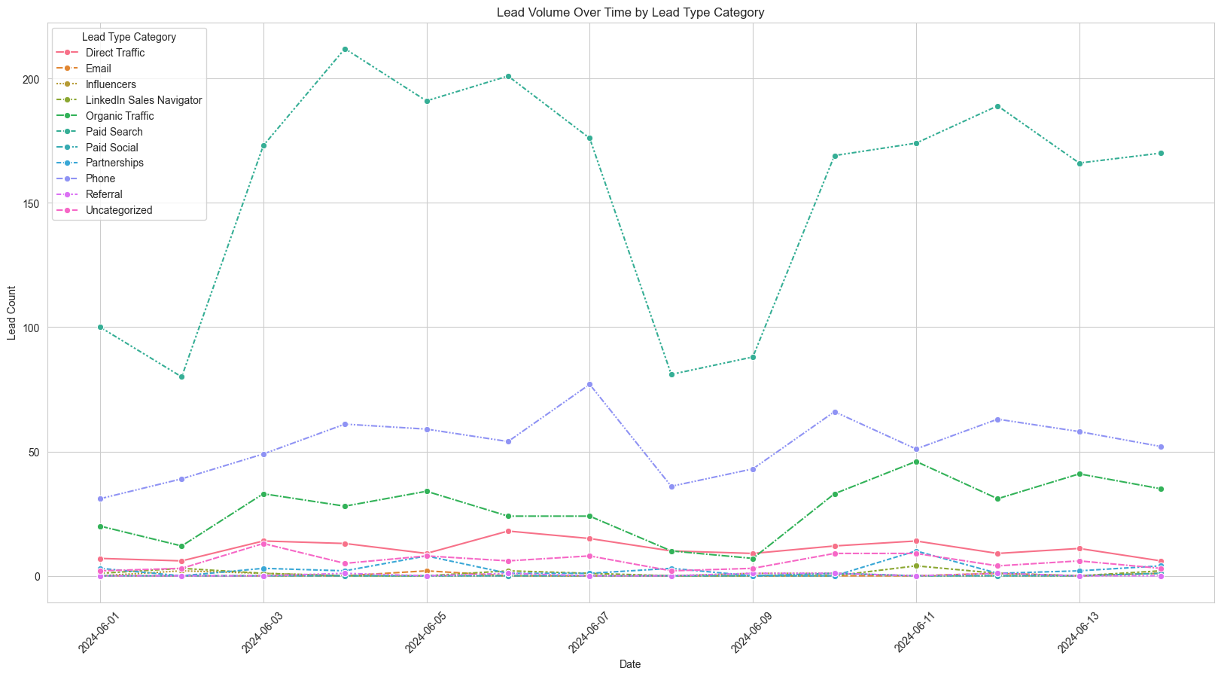
Key Data Insights
& Visuals
Patterns & Trends (Lead Volume Over Time by Lead Type Category)

Slide 7
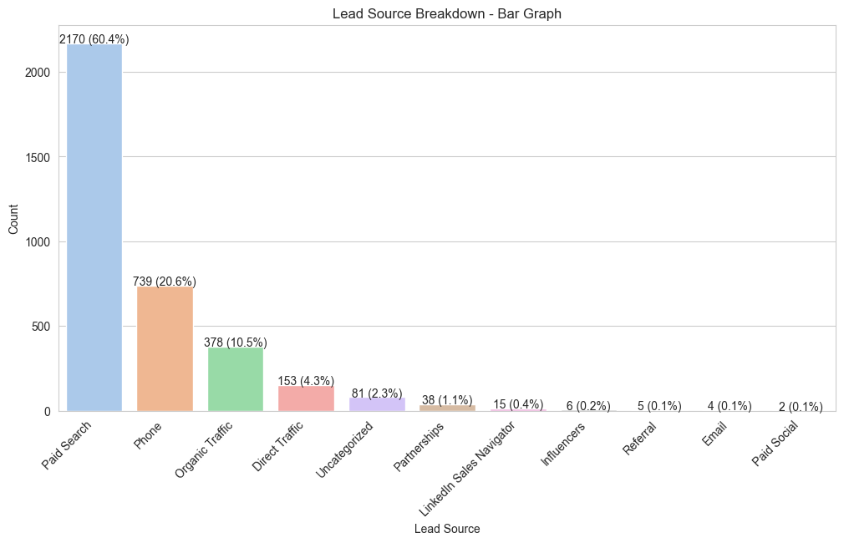
Key Data Insights
& Visuals
Patterns & Trends (Lead Source Breakdown)

Slide 8
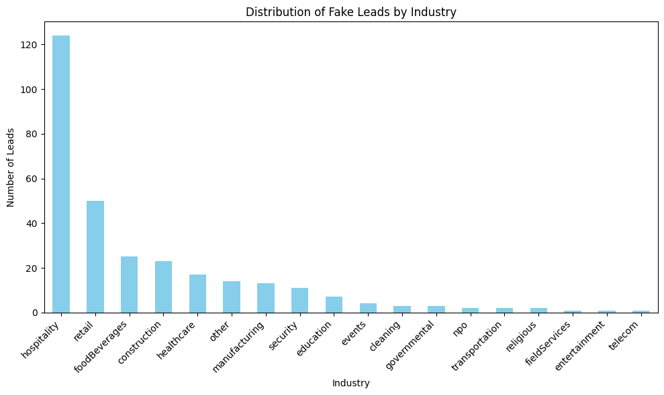
Key Data Insights
& Visuals
Patterns and Trends
(Fake Leads by industry)

Slide 9
Connecteam Home Assignment
February, 2025
Additional Metrics
Key Data Insights
🎯
Conversion Rates Overview
📌 Signup → MQL: 36.26% 📌 MQL → Demo: 30.11%
📌 Demo → Paid: 50.51%
📌 MQL → Paid: 35.02%.
🧩 What’s missing?
📊 Sales Rep Performance Data
Evaluate individual conversion rates at each funnel stage.
Identify high-performing reps and areas needing improvement.
📉 Churn & Retention Metrics
Measure post-conversion churn rates.
Set retention goals for 6+ months to reduce future drop-offs.
📢 Marketing Attribution Data
Track lead sources and link them to specific campaigns.
Optimize marketing spend by focusing on high-ROI channels.
🌍 Regions by Lead Volume
📌 North America – 2,033 leads 📌 Europe – 594 leads 📌 APAC – 582 leads 📌 Arab States – 153 leads 📌 Africa – 118 leads 📌 South America – 66 leads 📌 Israel – 40 leads 📌 Other – 5 leads

Slide 10

Connecteam Home Assignment
February, 2025
Hubspot
Integration &
Reports
Hubspot Free limited the ability to create reports and dashboards.
Reports and DB found in tableau instead for the first 1,000 leads.

Slide 11
Connecteam Home Assignment
February, 2025
Optimize Conversion Stages: Enhance MQL → Demo and Demo → Paid processes (enablement, infrastructure, SLA) to improve conversion by 5-10%.
Next Steps
Refine Forecasting & ROI: Collect data on closed-won vs. churn and marketing attribution for better insights.
Sales Performance Analysis: Assess rep performance and identify training needs based on conversion data.

Slide 12
Connecteam Home Assignment
February, 2025
Q&A and Discussion
Github

Slide 13
Thank you
Connecteam Home Assignment
February, 2025

